Slide 1
Sprint Review 9/15
Deadpool24

Slide 2
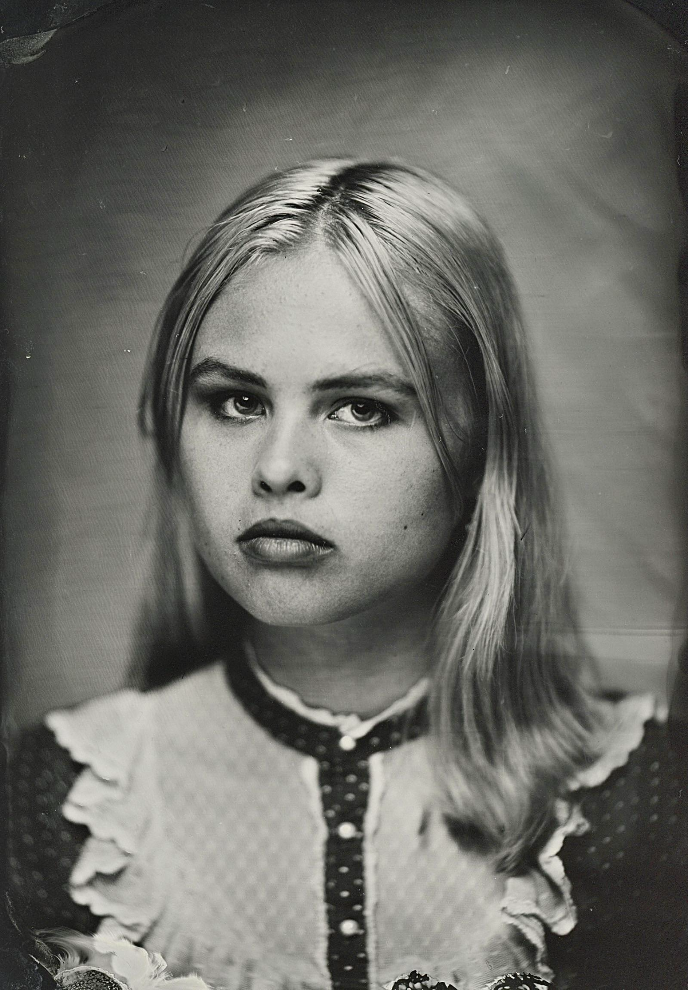

Thea
Michelson
Chad Waltenberg
phot

Slide 3
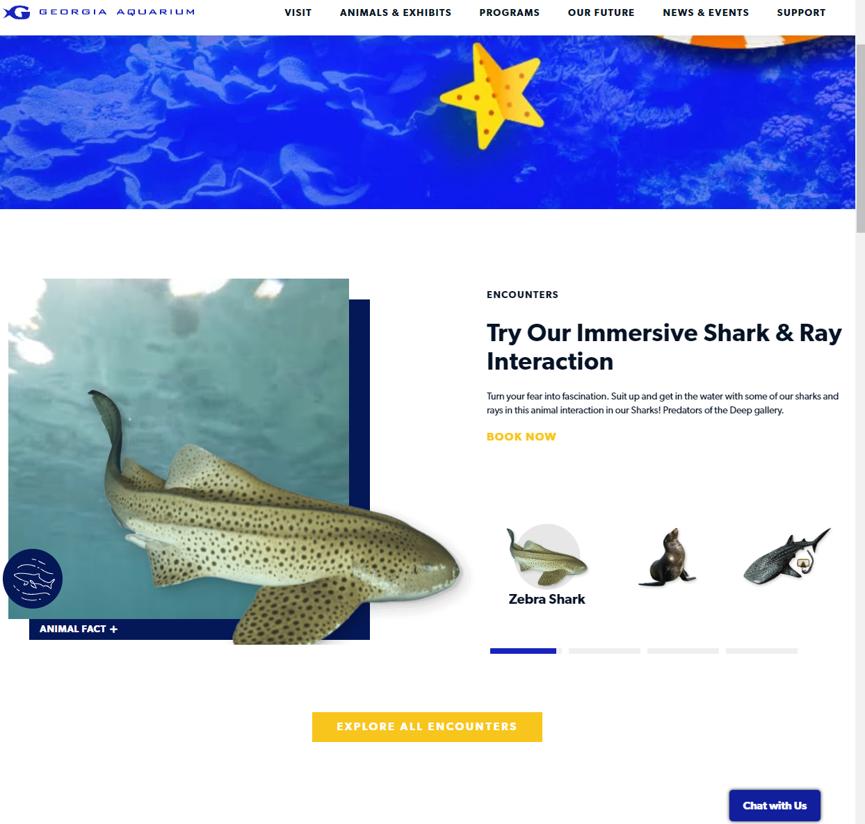
Our Project
-Aquarium Themed
-ASP.NET MVC Entity Framework
Inspiration:
Georgia Aquarium

Slide 4
Upcoming Features
Crud Operations for -
Guests
Workers
Tanks
Animals
Authorization & Authentication for users.
Validation on creating and editing data.
Transactional Data.
Roll Back.
User Friendly Design and setup for easy inputting and control.

Slide 5

Sprint Goals
Created landing page.

Slide 6
DEMO: Front Page

Slide 7
Feedback
Questions? Comments? Concerns?

